Slide 1
Ethics of medical technology
Barbro Fröding, babbi@kth.se
Ethics of Medical Technology 2024

Slide 2
Practical information
Learning goals:
After taking this module you should be familiar with the most common theories and methods of applied ethics and their relevance for medical technology. Further, you should be able to conduct independent moral reflections on practical problems in the ethics of medical technology both verbally and in writing.
How to reach the goals:
Three lectures and two seminars (all are mandatory)
Home assignments (Canvas submissions with non-negotiable deadlines and requirements)
Final essay writing seminar (December 6th, re-take in January)

Slide 3
Practical information
Two seminar groups:
Group 1 Me
Group 2 Martin Rissler
Please contact your seminar teacher(s) for practical questions about the seminars.
Seminar 1 – on zoom, link on Canvas
Seminar 2 – on zoom, link on Canvas

Slide 4
Important points
Carefully read through the entire Canvas page
All submissions of the assignments should be made through Canvas
  Submission forms for home assignments close at the start of each session
  Submission forms for compensation assignments open at the end of each session and close in January
The final essay writing session will take place in Room: K1 on the KTH Campus Date: 6th of December, 2024, Time; 13:00-17:00.
There will be a re-take in January (dates will be posted shortly)
  Each student will write two short essays on different problems in the ethics of medical technology, each answer should be 400-600 words
  You are not allowed a computer or books etc. in the exam.
    Read the example essays on Canvas for inspiration but note that the ones you are supposed to write will be much shorter.
Notes:
”Quite heavy workload/ECTS-ratio, but the knowledge you gain is worth it.”
”The course can only teach you as much as you are willing to learn.”
”I found the material very easy to absorb by just following the module as it was structured.”
”It is more fun when you participate in the discussions!”
”Attend it/do not miss”

Slide 5
lecture 1. Aim and method of applied ethics

Slide 6
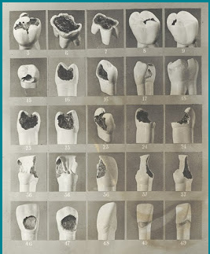
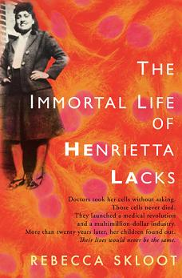

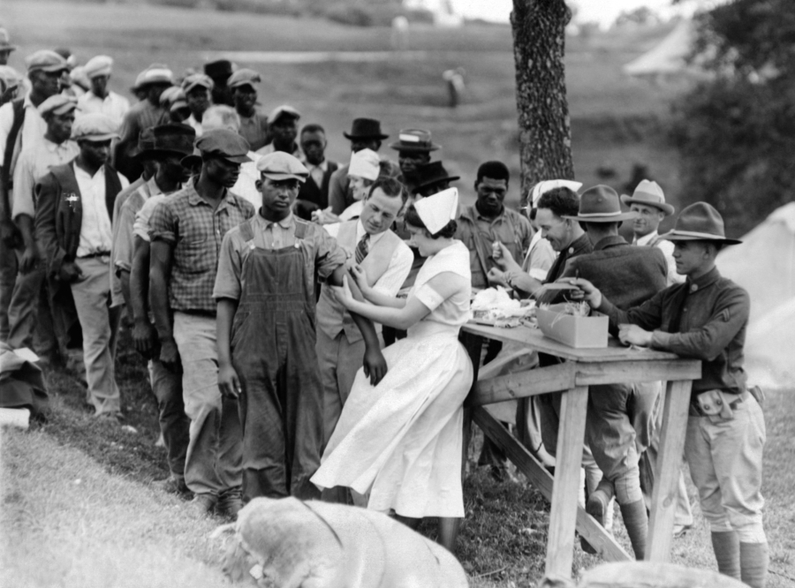
This Photo by Unknown Author is licensed under CC BY-SA
This Photo by Unknown Author is licensed under CC BY-NC-ND

Slide 7
Lecture 1: Aim and
methods of applied ethics
What is applied ethics?
Justification and methods in applied ethics
Principlism
Lecture 2: Paternalism in medical technologies
Lecture 3: Bias and algorithms
How to justify normative claims
Helping the developer to be more mindful about ethics

Slide 8

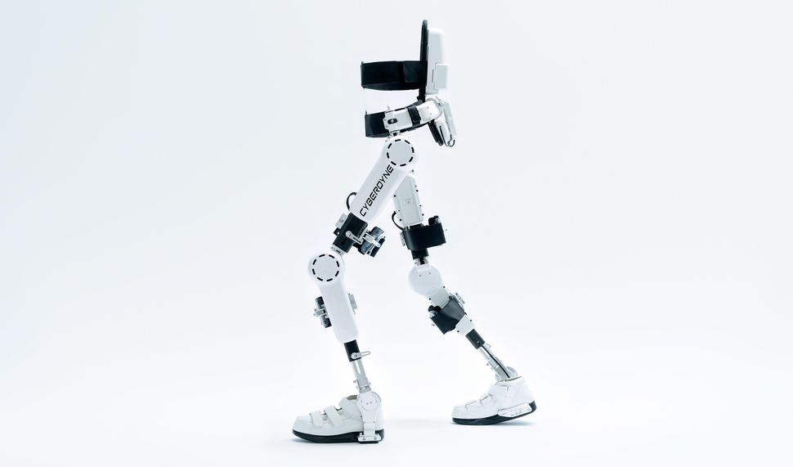
Smith and the exoskeleton
Smith is 95 years old. She has a limited understanding of the world around her and cannot move much without the help of her caretakers. A new technological device, a so-called exoskeleton, could increase her autonomy as it would enable her to move around her apartment without help. However, such autonomy would also enable her to, e.g., leave her building and wander off and do things that may not be good for her. She might have an accident or get lost.
Should Smith be provided with an exoskeleton?
This Photo by Unknown Author is licensed under CC BY-NC-ND

Slide 9
Different types of claims
Descriptive claims: “Smith is 95 years old.”
  This is a non-moral claim about a state of affairs in the past or present
Predicitive claims: “Smith will spend all her money on books.”
  This is a non-moral claim about a state of affairs in the future.
Evaluative claims: “It is good, for some, to have exoskeletons.”
  This is a moral claim which can be set in the present or the past
Prescriptive claims: “Smith should/should not be given an exoskeleton.”
  This is a moral claim set in the future

Slide 10
The aim of applied ethics is to provide normative guidance, i.e., prescriptions or evaluations, with regard to practical moral problems.

Slide 11
Take 5 min and think for yourself – are the claims below descriptive, predictive, prescriptive, or evaluative?
“The care providers will do a good job helping patients.”
“The woman is dying, help her!”
“Jones is specialized in treating lung cancer. She would prefer to focus all her available healthcare resources on non-smokers, if she could.”
“Providing expensive treatments to terminally ill people is wasteful.”
Notes:
“Are there any problems with any of these claims?”

Slide 12
Descriptive, predictive, prescriptive, or evaluative?
“The care providers will do their job helping patients.” Predictive
“The woman is dying, help her!” Prescriptive
“Jones is specialized in treating lung cancer. She would prefer to focus all her available healthcare resources on non-smokers, if she could.” Descriptive
“Providing expensive treatments to terminally ill people is wasteful.” Evaluative
The claims in 1 and 3 are easily assessed; just check the facts. But what about 2 and 4? How are normative claims justified?
Notes:
“Are there any problems with any of these claims?”

Slide 13
Justification of descriptive and predictive claims
To justify a claim is to propose convincing reasons in favor of it
Justifying descriptive claims
  “Smith is 95 years old.”
  Descriptive claims can be true or false, accurate and inaccurate, etc.
  Justifying the claim involves observing Smith’s birth certificate and the current year
Justifying predictive claims
  “Smith will spend all her money on books.”
  Predictive claims can be true or false, likely and unlikely, etc.
  Justifying the claim involves observing Smith’s history, her preferences etc.

Slide 14
Justification of normative claims
To justify a claim is to propose convincing reasons in favor of it
Justifying normative claims
  “Smith should be provided with an exoskeleton.”
  Can normative claims be true or false?
Justifying normative claims involves critical reflection on reasons that carry moral relevance.
  Identify and take into account relevant facts
  Identify the values involved and reflect upon these in light of other relevant values
  Identify and take into account possible value conflicts
Provide a balanced judgment with regard to all relevant reasons involved.

Slide 15
Identify the values and value conflicts
In groups for 10 min
“The exoskeleton would enable Smith to move around her apartment without help, but also to wander off and do things that are not good for her.”
“The technology that is used to remind dementia patients to take their medicine can also be used to monitor them when they do not know that they are being watched.”
“It’s not a real dog, it’s a smart robot. But my grandmother doesn’t seem to understand the difference anymore. They say things like, ‘I love you,’ to each other. The whole situation is awkward, but I think that she enjoys having someone to talk to and care for. Should I try to tell her that the dog is just a robot or should I let it go? Does it matter?”
Notes:
“This module provides a conceptual apparatus that you can use for normative analysis.”
Autonomy and well-being
Privacy and well-being
Authenticity and well-being
“Identifying the values and value-conflicts is the first step in moral analysis.”
Three approaches: top-down, bottom-up, and mid-level

Slide 16
Break 15 min

Slide 17

Justifying normative claims
Consider:
Facts
Values
Value-conflicts
Provide a balanced judgment with regard to all relevant reasons involved.
This Photo by Unknown Author is licensed under CC BY-NC-ND

Slide 18
A top-down approach
For instance, a top-down approach applying utilitarianism to the case:
  Utilitarianism is the theory that only states of affairs matter, and only happiness counts. Therefore, the question is what would produce the happiest state.
    Important: It is the amount of happiness in the world that counts, not the happiness for Smith (or anyone else in particular)
  “After some thinking, I believe that we should provide Smith with an unrestricted exoskeleton. The amount of happiness gained is greater than the suffering caused.”
Some problems
  How do we measure and compare happiness?
  What if utilitarianism is false? The top-down approach relies heavily on the truth of the theory applied and there is little agreement on this level of moral thinking (there are numerous competing normative theories)

Slide 19
A bottom-up approach
Consider what appears to be problematic cases from a morally neutral point of view
  Which are the main actors involved and what interests do they have?
    Smith, Smith’s family and neighbors, exoskeleton engineers and producers, etc.
  What realistic expectations can we have?
    How can we expect Smith to use the device? How will other people respond?
    Is the device expensive? Are some constraints to it more feasible than others?
Provide a balanced judgment taking all the above into account
Problem #1: Can analysts really be morally neutral?
Problem #2: Should they be?

Slide 20
A mid-level approach
Consider some theoretical concepts or principles in relation to practical concerns
  The information flow should be a two-way street between theory and practice
Principlism
  Beauchamp & Childress: Principles of Biomedical Ethics
  Theory: Respect for autonomy, nonmaleficence, beneficence, and justice
    These have been identified as the main areas of moral concern in biomedicine
    The result of both empirical observations and theoretical reflection
    Method: Specify how the principles apply to particular cases
    “In Smith and the exoskeleton there is a conflict between respecting autonomy and benefiting Smith.”
    Reflective equilibrium

Slide 21
Reflective equilibrium
Reflective equilibrium as a method in applied ethics
  Identify (and carefully articulate) the relevant facts, values, and value conflicts
  Identify (and carefully articulate) the moral intuitions involved
    What appears to be right upon stable and considered reflection
  Suggest a possible balanced normative judgment taking all the above into account
  Repeat! As a method, reflective equilibrium is a continuous process
Reflective equilibrium as a theory of justification in applied ethics
  Normative justification is a matter of degree rather than absolutism
  Normative claims are justified to the extent that they are coherent with all relevant reasons involved (both facts and values) and with our stable and considered moral intuitions with regard to the case
Notes:
“Coherent with all relevant reasons? This brings us to coherentism and foundationalism.”

Slide 22
Reflective equilibrium: Smith and the exoskeleton
Being dependent on others is sometimes a bad thing
People should be allowed to live as they like
We should contribute to others’ well-being
Smith should be provided with an
exoskeleton with no restrictions
Smith should be provided with an
exoskeleton with some restrictions
Autonomy is valuable
Healthcare resources should be justly distributed
We should try to prevent people from harming themselves
Notes:
Each individual proposition is justified to the extent that they are coherent with all other (relevant) propositions
Most propositions here are general. Now, we try to formulate a prescriptive claim in the particular case of Smith
Justice: The exoskeleton should not be too expensive

Slide 23
Ahlin marceta 2019 on reflective equilibrium
Reflective equilibrium is a coherentist theory of moral justification.
“As a theory of moral justification, reflective equilibrium is the theory that a moral claim is reason-giving if it is coherent with all other beliefs (in moral and non-moral matters) and with our stable and considered moral intuitions. For instance, the claim, “ceteris paribus, people who suffer should be helped,” is justified not because it is true, but because it is coherent with all other beliefs and with our moral intuitions. (p.8).

Slide 24
Principlism: Respect for autonomy
From the Greek auto (“self”) and nomos (“law”): Self-guidance, self-governance:
Beauchamp and Rauprich (2016) two conditions of autonomy. (1) Liberty – absence of controlling influences; (2) Agency – self-initiated intentional action.
” Personal autonomy is self-rule free from both controlling interference by others and from limitations that prevent meaningful choice, such as inadequate understanding. The autonomous individual acts freely in accordance with a self-chosen plan, analogous to the way an independent government manages its territories and sets its policies. The principle of respect for autonomy protects the rights of individuals to hold certain views and to make certain kinds of choices. ”(2016, 2284)

Slide 25
Principlism: Nonmaleficence
Do not cause harm or risk of harm to others
Here, not ”harming” others means not setting back their welfare interests
Welfare interests include
  Health, mental and physical fitness
  Social inclusion and opportunities

Slide 26
Principlism: Beneficence
Act to benefit others
Negative and positive obligations
  Nonmaleficence is an obligation to not act, i.e., a negative obligation
  Beneficence, by contrast, is an obligation to act, i.e., a positive obligation
Obligations to
  Prevent harms from occurring
  Promote others’ welfare interests

Slide 27
Principlism: Justice
Fair and appropriate treatment in light of what is due or owed to individuals
Various principles of distributive justice
  Equality: Same treatment for all no matter their background or identity
  Desert: Different treatment for different persons due to their own actions and choices
  Need: Allocate scarce resources so that any inequalities benefit the worst-off

Slide 28
Principlism: Method for application
Beauchamp and Rauprich 2016, 2285-6:
“Principlism … holds that its principles must be specified to give concrete guidance about when and how to obtain an informed consent, how much information must be disclosed, how to maintain confidentiality, and the like. Specification is not a process of producing, explaining, or defending general principles, but of making them relevant and useful in specific contexts … As Henry Richardson puts it, specification occurs by “spelling out where, when, why, how, by what means, to whom, or by whom the action is to be done or avoided (Richardson 1990, 2000).”

Slide 29
Principlism: Method for application
Render principles practical through specification
  Tentatively decide which principles apply to a particular case
  Specify in detail how they apply
  If conflicts between principles occur,
    Re-evaluate, seek a balanced judgment
    Accept that more than one of the identified answers can be right

Slide 30
Smith and the exoskeleton: Which principles apply?
Smith is 95 years old. She has a limited understanding of the world around her and cannot move much without the help of her caretakers. A new technological device, a so-called exoskeleton, could increase her autonomy as it would enable her to move around her apartment without help. However, such autonomy would also enable her to, e.g., leave her building and wander off and do things that may not be good for her.
Which principles apply?
Respect for autonomy: Self-governance
Non-maleficence: Do not cause harm or risk of harm to others
Beneficence: Act to benefit others
Justice: Fair and appropriate treatment in light of what is due or owed to individuals

Slide 31
Principlism: Smith and the exoskeleton (1/2)
Tentatively decide which principles apply to a particular case
  Respect for autonomy, beneficence, nonmaleficence
Specify in detail how they apply
  Smith’s autonomy is promoted as the exoskeleton enables her to do things that she is otherwise not capable of doing
  Having an exoskeleton may promote Smith’s welfare interests, such as her physical and mental health, and her social inclusion and opportunities
  It may also harm her welfare interests, as the exoskeleton would enable Smith to walk outside on her own and risk getting lost, buying too many books etc.

Slide 32
Principlism: Smith and the exoskeleton (2/2)
Conflicts between principles occur in this case. Thus,
  Re-evaluate, seek a balanced judgment
    The autonomy-related reasons involved are very strong
    So are the welfare-related reasons
    The autonomy-related reasons outweigh the welfare-related reasons on some accounts, such as that it enables Smith to move around the house
Prescription: Smith should be provided with an exoskeleton with some restrictions!
Repeat 1–3 until a balanced judgment is reached taking all relevant reasons into account!

Slide 33
To summarize
This lecture
What is applied ethics?
  The aim of applied ethics is to provide normative guidance, i.e., prescriptions or evaluations, with regard to practical moral problems
Justification and methods in applied ethics
  To justify a claim is to propose convincing reasons in favor of it
  Top-down, bottom-up, mid-level
Principlism
  Four principles: Respect for autonomy, nonmaleficence, beneficence, and justice
  Method: Reflective equilibrium, specificationism

Slide 34
Reflective equilibrium: A foundationalist alternative
Consider this example of foundationalist justification, in contrast to reflective equilibrium:
Therefore, Smith should be provided
with an exoskeleton
Smith has an interest in spending her money on lottery tickets and fried chicken
Therefore, everyone has the right to further their own interests
Life is the ultimate moral value
Notes:
Case: Should the PhD student recommend publication or rejection?

Slide 35
Reflective equilibrium: A foundationalist alternative
Consider this example of foundationalist justification, in contrast to reflective equilibrium:
Therefore, Smith should be provided
with an exoskeleton
Smith has an interest in spending her money on cookies and donuts.
Therefore, everyone has the right to further their own interests
Life is the ultimate moral value
Notes:
Case: Should the PhD student recommend publication or rejection?

